Slide 1
Lecture Twelve Metals for Casting
Most commercial castings are made of alloys rather than pure metals
Alloys are generally easier to cast, and properties of product are better
Casting alloys can be classified as:
Ferrous
Nonferrous

Slide 2
Ferrous Casting Alloys: Cast Iron
Most important of all casting alloys
Tonnage of cast iron castings is several times that of all other metals combined
Several types: (1) gray cast iron, (2) nodular iron, (3) white cast iron, (4) malleable iron, and (5) alloy cast irons
Typical pouring temperatures ∼ 1400°C (2500°F), depending on composition

Slide 3
Ferrous Casting Alloys: Steel
The mechanical properties of steel make it an attractive engineering material
The capability to create complex geometries makes casting an attractive shaping process
Difficulties when casting steel:
Pouring temperature is high ∼ 1650°C (3000°F)
At such temperatures, steel readily oxidizes, so molten metal must be isolated from air
Molten steel has relatively poor fluidity

Slide 4
Nonferrous Casting Alloys: Aluminum
Generally considered to be very castable
Low pouring temperatures due to low melting temperature
Pure Aluminum T_{m} = 660°C (1220°F)
Properties:
Light weight
Range of strength properties by heat treatment
Easy to machine

Slide 5
Nonferrous Casting Alloys: Copper Alloys
Includes bronze, brass, and aluminum bronze
Properties:
Corrosion resistance
Attractive appearance
Good bearing qualities
Limitation: high cost of copper
Applications: pipe fittings, marine propeller blades, pump components, ornamental jewelry

Slide 6
Nonferrous Casting Alloys: Zinc Alloys
Very castable, commonly used in die casting
Low pouring temperatures due to low melting temperature
Pure zinc T_{m} = 419°C (786°F)
Good fluidity for ease of casting
Properties:
Low creep strength, so castings cannot be subjected to prolonged high stresses

Slide 7
Product Design Considerations
Geometric simplicity
Although casting can be used to produce complex part geometries, simplifying the part design usually improves castability
Avoiding unnecessary complexities:
Simplifies mold‑making
Reduces the need for cores
Improves the strength of the casting

Slide 8
Product Design Considerations
Corners on the casting
Sharp corners and angles should be avoided, since they are sources of stress concentrations and may cause hot tearing and cracks
Generous fillets should be designed on inside corners and sharp edges should be blended

Slide 9
Product Design Considerations
Draft Guidelines
In expendable mold casting, draft facilitates removal of pattern from mold
Draft = 1° for sand casting
In permanent mold casting, purpose is to aid in removal of the part from the mold
Draft = 2° to 3° for permanent mold processes
Similar tapers should be allowed for solid cores

Slide 10
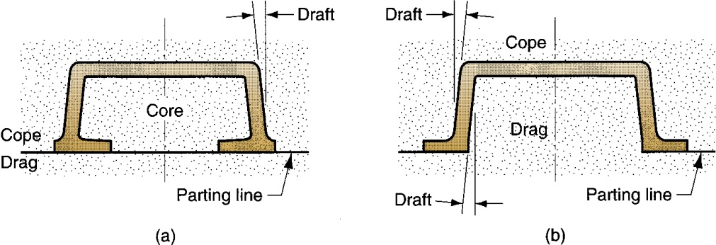
Draft
Design change to eliminate need for using a core: (a) original design, and (b) redesign

Slide 11
Product Design Considerations
Dimensional Tolerances and Surface Finish
Dimensional accuracy and finish vary significantly, depending on process
Poor dimensional accuracies and finish for sand casting
Good dimensional accuracies and finish for die casting and investment casting

Slide 12
Product Design Considerations
Machining Allowances
Almost all sand castings must be machined to achieve the required dimensions and part features
Additional material, called the machining allowance, is left on the casting in those surfaces where machining is necessary
Typical machining allowances for sand castings are around 1.5 and 3 mm (1/16 and 1/4 in)

Slide 13
Example 1
(USCS units) Caplets are used to support a sand core inside a sand mold cavity. The design of the caplets and the manner in which they are placed in the mold cavity surface allows each caplet to sustain a force of 8 lb. Several caplets are located beneath the core to support it before pouring; and several other caplets are placed above the core to resist the buoyancy force during pouring. If the volume of the core = 120 in³, and the metal is brass, determine the minimum number of caplets that should be placed (a) beneath the core, and (b) above the core.
Solution: Sand density = 0.058 lb/in³. From Table 11.1, density of brass ρ = 0.313 lb/in³.
(a) W_{c} = 120(0.058) = 6.96 lb
Although the ratio 6.96/8 is less than 1, to be safe, 2 caplets should be used beneath to support the weight of the core before pouring. Probably 3 or 4 caplets would be better to achieve stability.
(b) W_{m} = 120(.313) = 37.56 lb
F_{b} = 37.56 - 6.96 = 30.6 lb
A minimum of 4 caplets are required above the core to resist the buoyancy force.

Slide 14
Example 2
(USCS units) A horizontal true centrifugal casting operation is performed to make cast iron pipe. The pipes have a length = 72.0 in, outside diameter = 6.0 in, and wall thickness = 0.375 in. (a) If the rotational speed of the pipe = 750 rev/min, determine the G‑factor. (b) Is the operation likely to be successful? (c) If not, what should the rotational speed be to achieve a G-factor of 60?
Solution: (a) Using outside wall of casting, R = 0.5(6)/12 = 0.25 ft
v = πRN/30 = π(0.25)(750)/30 = 19.63 ft/sec.
GF = v²/Rg = (19.63)²/(0.25 x 32.2) = 47.9
(b) Since the G-factor is less than 60, the rotational speed is not sufficient, and the operation is likely to be unsuccessful.
(c) Using a G-factor = 60, N = (30/π)(2 x 32.2 x 60/(6/12))^{0.5} = 9.55(7728)^{0.5} = 840 rev/min

Slide 15
Example 3
(SI units) Horizontal true centrifugal casting is used to make aluminum rings with length = 5 cm, outside diameter = 65 cm, and inside diameter = 60 cm. (a) Determine the rotational speed that will provide a G‑factor = 60. (b) Suppose that the ring were made out of steel instead of aluminum. If the rotational speed computed in part (a) were used in the steel casting operation, determine the G‑factor and (c) centrifugal force per square meter (Pa) on the mold wall. (d) Would this rotational speed result in a successful operation? The density of steel = 7.87 g/cm³.
Solution: (a) Use inside diameter of mold in Eq. (11.5), D = D_{o} = 65 cm. Use g = 981 cm/s²,
N = 30(2g x GF/D)^{.5}/π = 30(2 x 981 x 60/65)^{.5}/π = 406.4 rev/min
(b) Rotational speed would be the same as in part (a) because mass does not enter the computation of rotational speed. N = 406.4 rev/min
(c) Use 5 cm ring length as basis of area calculations.
Area of this length of mold wall A = πD_{o}L = π(65 cm)(5 cm) = 1021 cm² = 0.1021 m²
Volume of cast metal V = π(R_{o}² - R_{i}²)(L) = π((65/2)² - (60/2)²)(5.0) = 2454.4 cm³
Density of steel ρ = 7.87 g/cm³
Mass m = (7.87g/cm³)(2454.4 cm³) = 19,315.9 g = 19.316 kg
v = πRN/30 Use mean radius R = (65 + 60)/4 = 31.25 cm = 0.3125 m
v = π(31.25)(406.4)/30 = 1329.9 cm/s = 13.299 m/s
Centrifugal force per square meter on mold wall = F_{c}/A where F_{c} = mv²/R
F_{c} = (19.316 kg)(13.299 m/s)²/(0.3125 m) = 10,932.1 kg-m/s²
Given that 1 N = 9.81 kg-m/s², F_{c} = 10,932.1/9.81 = 1114.4 N
F_{c}/A = (1114.4 N)/(0.1021 m²) = 10,914.7 N/m² = 10,914.7 Pa
(d) The G-factor of 60 would probably result in a successful casting operation.

